Slide 1




Next Gen Employability Program
Full Stack Web Development with AI Tools
Team Details – NG_CP_Team_350
Name: Sudhanshu Gupta
Name: Kumari Shobha
Name: Taniya Yadav
College: Meerut Institute of Technology, Meerut

Slide 2

The content is curated from online/offline resources and used for educational purpose only.
Notes:
Speaker would be briefing the students that this content has been prepared for the educational purpose only and is referred from multiple sites which are cited in the last.​​
---------------------------------------------------​​
A disclaimer is a statement or notice that is intended to clarify, limit, or provide information about the scope, limitations, or potential risks associated with certain actions, information, products, services, or content. ​​
​​
​

Slide 3

Project Title
Fields & Finds - Agricultural Tools Rental System
Notes:
In this slide speaker will be introducing the program and its outcomes. The speaker will introduce himself in brief

Slide 4

Table of Contents
Introduction
Problem Statement
Proposed Solution
Key features
Technology stack
System flowchart
Core Modules
Conclusion and Future work
References
Notes:
This slide, The speaker will talk about the content that we will be covering in this session as follows:
Introduction
Importance of UI/UX in industry
History and Definitions of UI and UX
Key Differences between UI/UX
Use Cases
Significance in Web Development
Use Cases
Visual Design Principles
Design process
Color theory and psychology
Typography and readability
Layout and Spacing
Responsive design basics
Usability and Accessibility
Usability Aspects
Web Content Accessibility Guidelines (WCAG)
Inclusive design practices
Consistency
User Experience
User-Centered Design
User research methods
Interactive Elements and Feedback
Mini Case Study
Discussing a popular UI/UX design
Hands-On
Introduction to Figma for UI/UX design

Slide 5
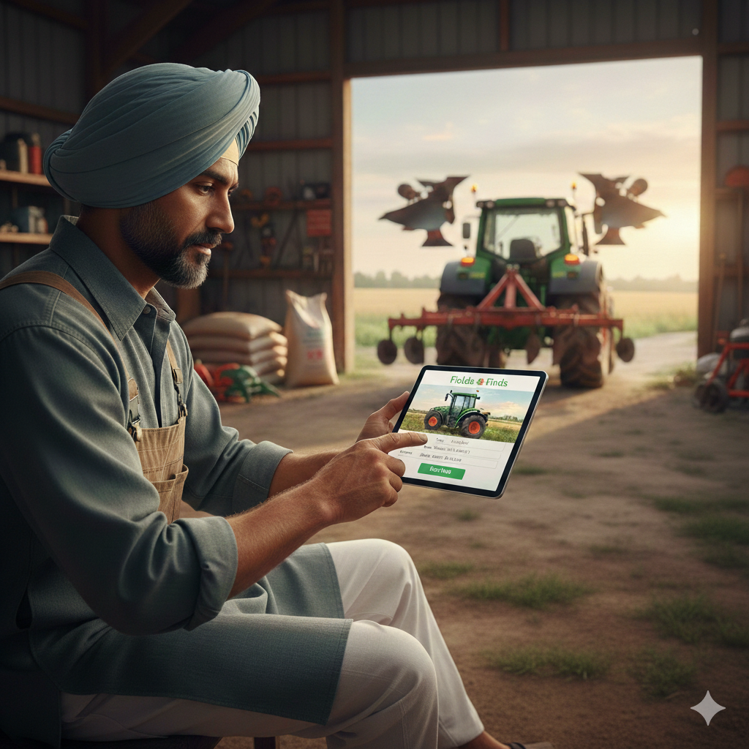
Introduction
Agriculture is the backbone of the Indian economy, yet small and marginal farmers often struggle to access modern agricultural tools due to high ownership costs and short seasonal usage. Traditional rental systems are mostly unorganized, offline, and lack transparency and trust.
Fields & Finds is a web-based platform designed to enable farmers to lend and rent agricultural tools at low cost, ensuring affordability, transparency, and trust through digital workflows, verification mechanisms, and admin moderation.
Notes:
This slide, The speaker will talk about the content that we will be covering in this session as follows:
Introduction
Importance of UI/UX in industry
History and Definitions of UI and UX
Key Differences between UI/UX
Use Cases
Significance in Web Development
Use Cases
Visual Design Principles
Design process
Color theory and psychology
Typography and readability
Layout and Spacing
Responsive design basics
Usability and Accessibility
Usability Aspects
Web Content Accessibility Guidelines (WCAG)
Inclusive design practices
Consistency
User Experience
User-Centered Design
User research methods
Interactive Elements and Feedback
Mini Case Study
Discussing a popular UI/UX design
Hands-On
Introduction to Figma for UI/UX design

Slide 6
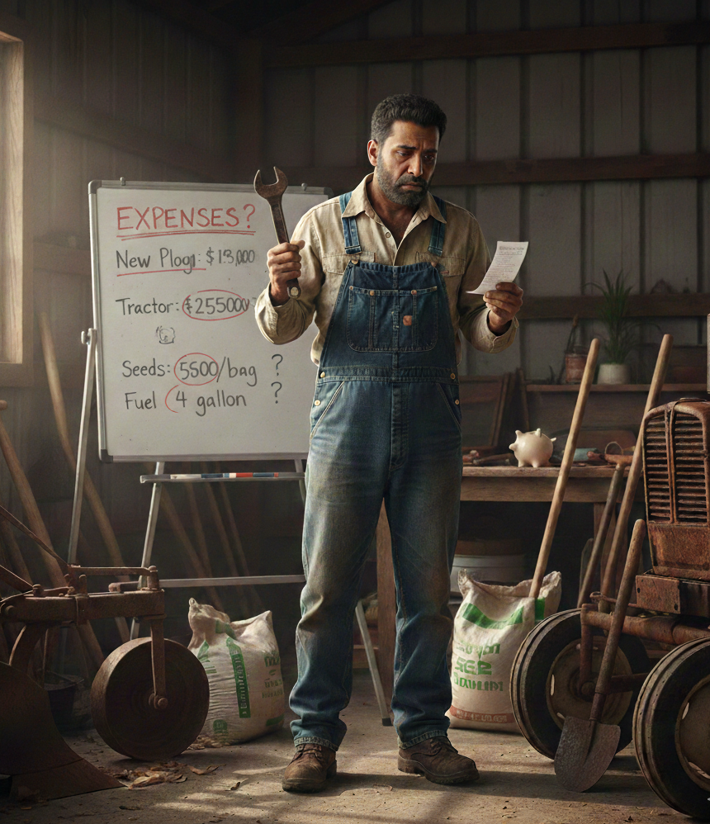
Problem Statement
Farming tools are expensive and not affordable for many small farmers
Many tools remain unused when not in regular use
Farmers struggle to find tools when needed
No proper digital platform for tool lending and rental
Notes:
This slide, The speaker will talk about the content that we will be covering in this session as follows:
Introduction
Importance of UI/UX in industry
History and Definitions of UI and UX
Key Differences between UI/UX
Use Cases
Significance in Web Development
Use Cases
Visual Design Principles
Design process
Color theory and psychology
Typography and readability
Layout and Spacing
Responsive design basics
Usability and Accessibility
Usability Aspects
Web Content Accessibility Guidelines (WCAG)
Inclusive design practices
Consistency
User Experience
User-Centered Design
User research methods
Interactive Elements and Feedback
Mini Case Study
Discussing a popular UI/UX design
Hands-On
Introduction to Figma for UI/UX design

Slide 7
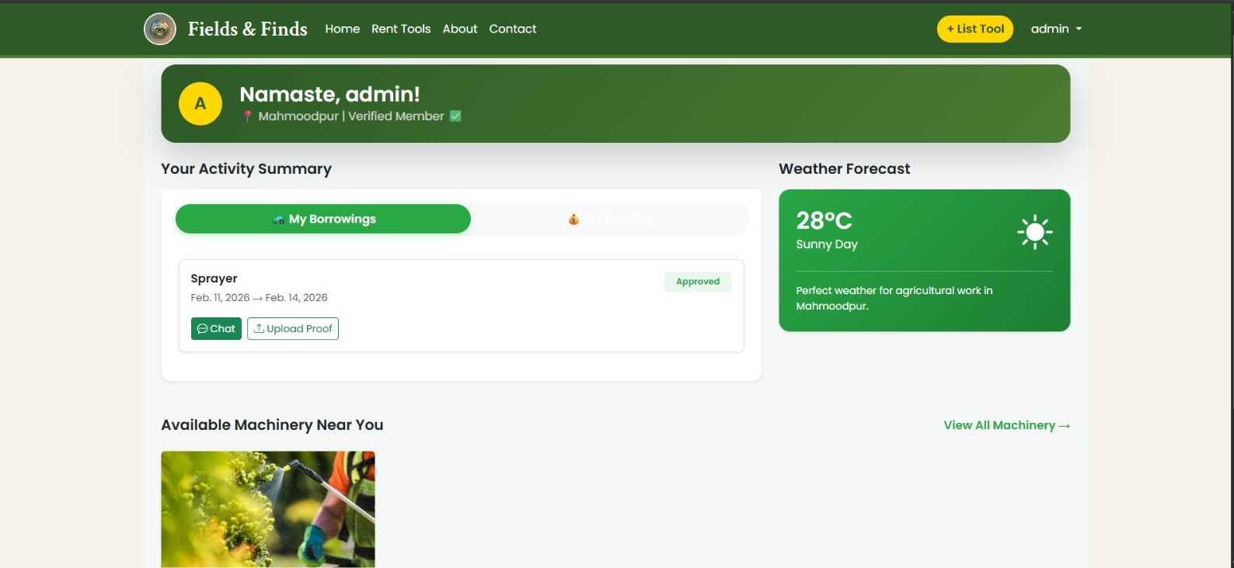
Proposed Solution
The proposed system is a web-based agricultural tool sharing platform that allows farmers to:
List unused tools for rent
Rent nearby tools at affordable rates
Book tools transparently with availability tracking
Communicate securely through in-platform chat
Upload photo proof to avoid disputes
Build trust through verified reviews and admin
Notes:
This slide, The speaker will talk about the content that we will be covering in this session as follows:
Introduction
Importance of UI/UX in industry
History and Definitions of UI and UX
Key Differences between UI/UX
Use Cases
Significance in Web Development
Use Cases
Visual Design Principles
Design process
Color theory and psychology
Typography and readability
Layout and Spacing
Responsive design basics
Usability and Accessibility
Usability Aspects
Web Content Accessibility Guidelines (WCAG)
Inclusive design practices
Consistency
User Experience
User-Centered Design
User research methods
Interactive Elements and Feedback
Mini Case Study
Discussing a popular UI/UX design
Hands-On
Introduction to Figma for UI/UX design

Slide 8
Key Features
Ratings
Approval
Proof Upload
Dispute Reporting
Weather Information
In-Platform Chat
Tool listing with admin approval
Pickup & return proof upload
Ratings and reviews after booking completion
Dispute reporting
In-platform chat (borrower ↔ lender)
Weather information for farming planning
Notes:
This slide, The speaker will talk about the content that we will be covering in this session as follows:
Introduction
Importance of UI/UX in industry
History and Definitions of UI and UX
Key Differences between UI/UX
Use Cases
Significance in Web Development
Use Cases
Visual Design Principles
Design process
Color theory and psychology
Typography and readability
Layout and Spacing
Responsive design basics
Usability and Accessibility
Usability Aspects
Web Content Accessibility Guidelines (WCAG)
Inclusive design practices
Consistency
User Experience
User-Centered Design
User research methods
Interactive Elements and Feedback
Mini Case Study
Discussing a popular UI/UX design
Hands-On
Introduction to Figma for UI/UX design

Slide 9
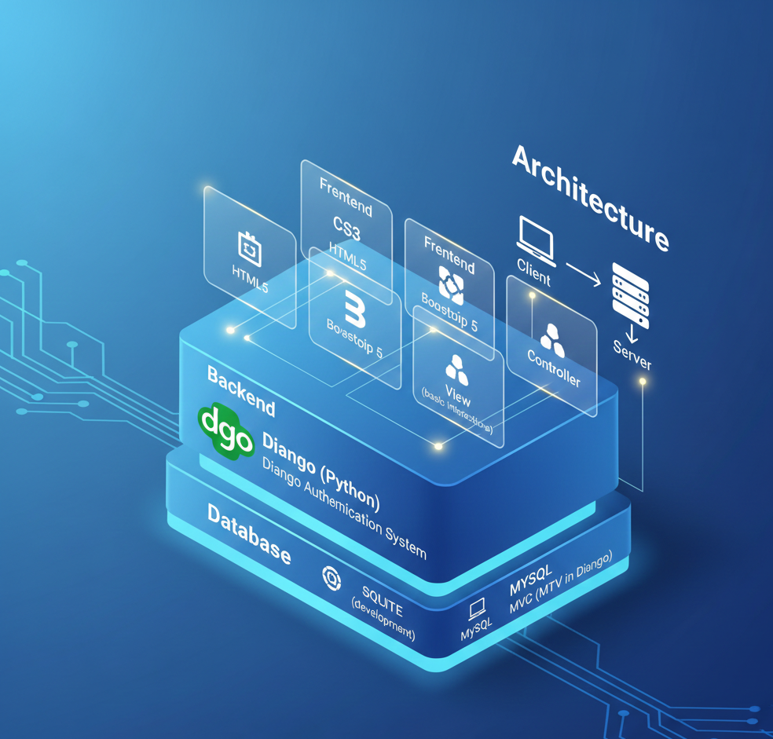
Technology Stack
Frontend
HTML5, CSS3, Bootstrap 5, JavaScript
Backend
Django with Python
Database
SQLite
Architecture
Client–Server
Notes:
This slide, The speaker will talk about the content that we will be covering in this session as follows:
Introduction
Importance of UI/UX in industry
History and Definitions of UI and UX
Key Differences between UI/UX
Use Cases
Significance in Web Development
Use Cases
Visual Design Principles
Design process
Color theory and psychology
Typography and readability
Layout and Spacing
Responsive design basics
Usability and Accessibility
Usability Aspects
Web Content Accessibility Guidelines (WCAG)
Inclusive design practices
Consistency
User Experience
User-Centered Design
User research methods
Interactive Elements and Feedback
Mini Case Study
Discussing a popular UI/UX design
Hands-On
Introduction to Figma for UI/UX design

Slide 10
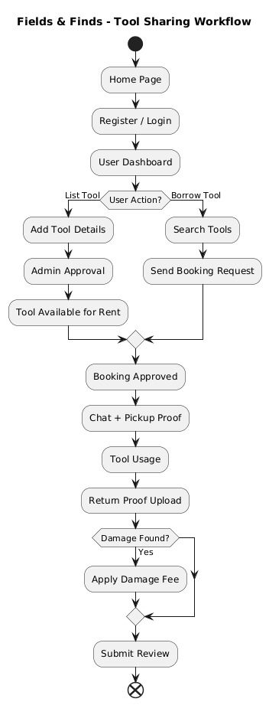
System Flowchart
Notes:
This slide, The speaker will talk about the content that we will be covering in this session as follows:
Introduction
Importance of UI/UX in industry
History and Definitions of UI and UX
Key Differences between UI/UX
Use Cases
Significance in Web Development
Use Cases
Visual Design Principles
Design process
Color theory and psychology
Typography and readability
Layout and Spacing
Responsive design basics
Usability and Accessibility
Usability Aspects
Web Content Accessibility Guidelines (WCAG)
Inclusive design practices
Consistency
User Experience
User-Centered Design
User research methods
Interactive Elements and Feedback
Mini Case Study
Discussing a popular UI/UX design
Hands-On
Introduction to Figma for UI/UX design

Slide 11
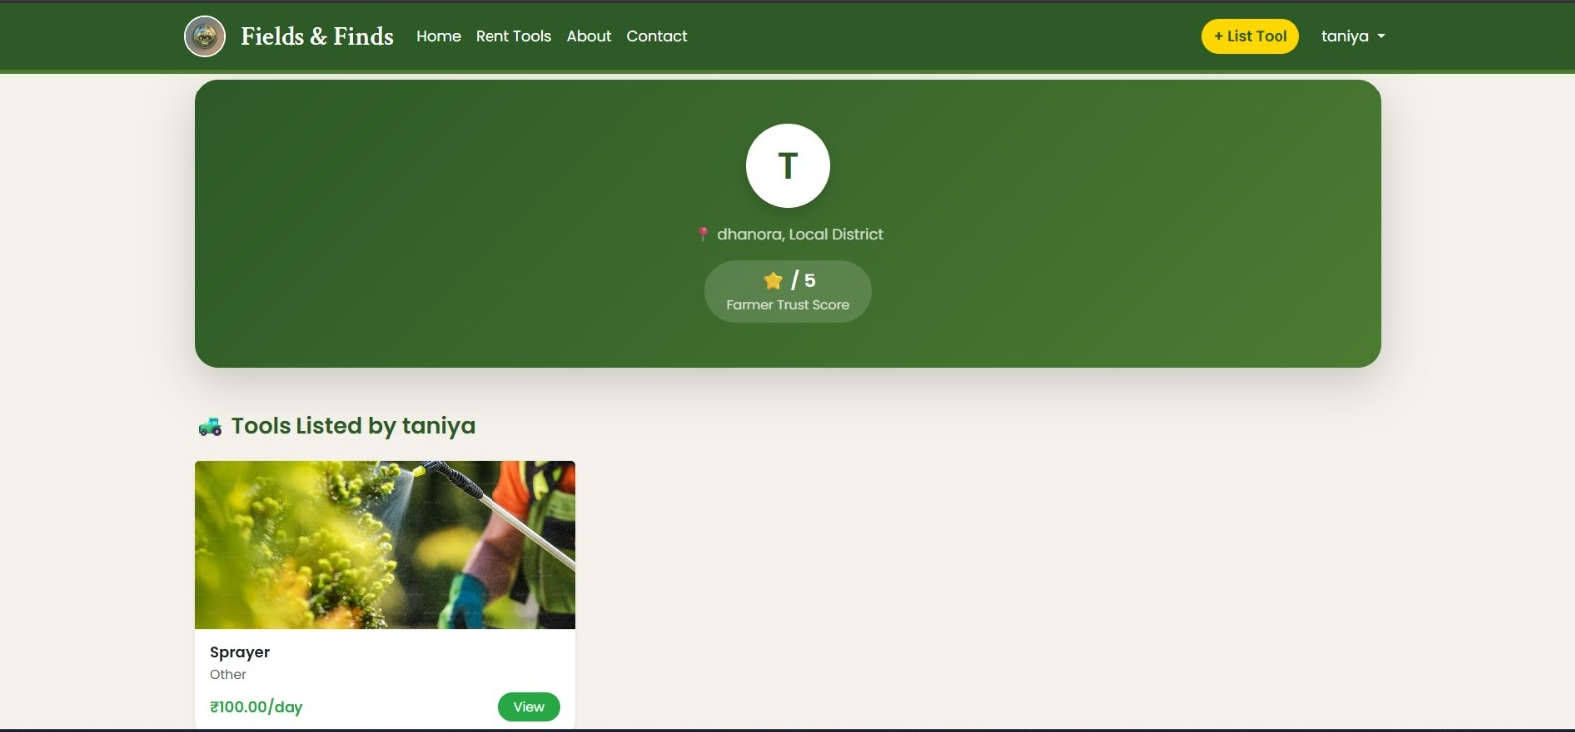

Slide 12
Conclusion And Future Work
Fields & Finds provides a practical, scalable, and farmer-centric solution to reduce agricultural tool costs through shared access. By integrating verification, booking workflows, digital proof, and admin moderation, the platform ensures trust, transparency, and affordability.
Future Enhancements
Mobile application (Android)
GPS-based tool discovery
Online payments
Multilingual support
Notes:
This slide, The speaker will talk about the content that we will be covering in this session as follows:
Introduction
Importance of UI/UX in industry
History and Definitions of UI and UX
Key Differences between UI/UX
Use Cases
Significance in Web Development
Use Cases
Visual Design Principles
Design process
Color theory and psychology
Typography and readability
Layout and Spacing
Responsive design basics
Usability and Accessibility
Usability Aspects
Web Content Accessibility Guidelines (WCAG)
Inclusive design practices
Consistency
User Experience
User-Centered Design
User research methods
Interactive Elements and Feedback
Mini Case Study
Discussing a popular UI/UX design
Hands-On
Introduction to Figma for UI/UX design

Slide 13
References
Python – https://www.python.org
Django – https://www.djangoproject.com
SQLite – https://www.sqlite.org
Bootstrap – https://getbootstrap.com
HTML, CSS, JavaScript – https://developer.mozilla.org
Notes:
This slide, The speaker will talk about the content that we will be covering in this session as follows:
Introduction
Importance of UI/UX in industry
History and Definitions of UI and UX
Key Differences between UI/UX
Use Cases
Significance in Web Development
Use Cases
Visual Design Principles
Design process
Color theory and psychology
Typography and readability
Layout and Spacing
Responsive design basics
Usability and Accessibility
Usability Aspects
Web Content Accessibility Guidelines (WCAG)
Inclusive design practices
Consistency
User Experience
User-Centered Design
User research methods
Interactive Elements and Feedback
Mini Case Study
Discussing a popular UI/UX design
Hands-On
Introduction to Figma for UI/UX design

